Slide 1
Agriculture, Food, and Natural Resources Education Master of Arts
Dual/Linked MA Admissions
https://www.canr.msu.edu/csus/graduate/programs/afnre/

Slide 2
Objectives
Upon completion of video, AFNRE BS students will be able to:
Determine an appropriate timeline for their dual/linked program;
Determine how to apply for the dual/linked program;
Determine appropriate tasked associated with applying to the AFNRE MA program as a AFNRE undergraduate.
https://www.canr.msu.edu/csus/graduate/programs/afnre/

Slide 3
How to Apply to the Dual/Linked program
There are several steps in the dual/linked program to consider when applying. These steps can be found in the AFNRE Undergraduate Student Handbook
Complete the request for dual application (Linked BS/MA Program Application)
Determine an appropriate Graduate Program Advisor (Contact Dr. Everett for a list)
Determine an appropriate Graduate Program Plan (Course Program)
Apply to MSU as a graduate student in the AFNRE MA program (https://explore.msu.edu/apply/)
https://www.canr.msu.edu/csus/graduate/programs/afnre/

Slide 4
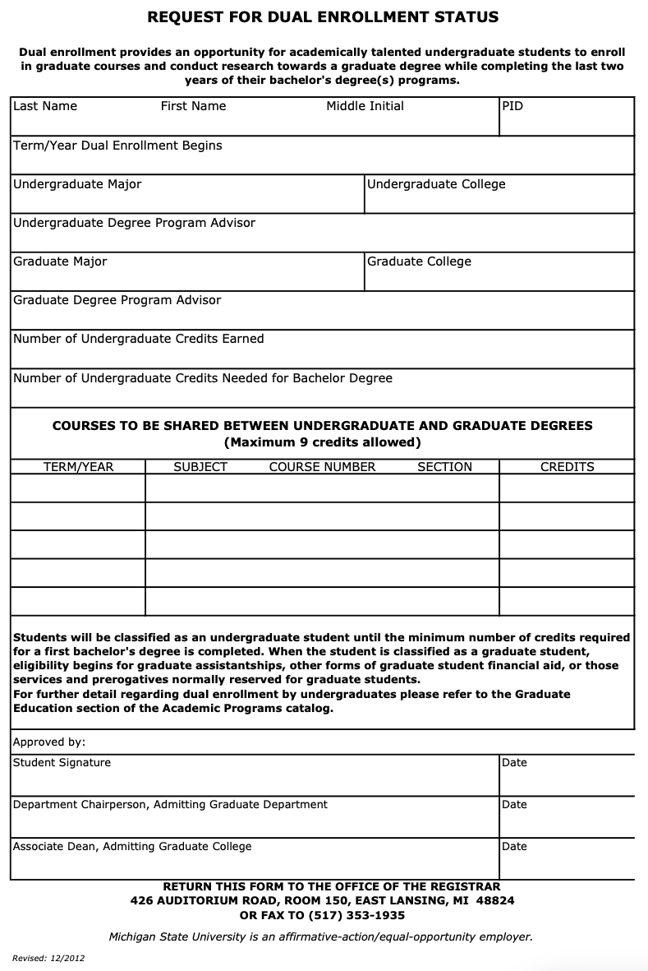
1) Complete the request for dual application
Complete the document in the link from the previous slide (PDF)
You should be able to provide all of the information up to the courses section
The courses include:
FS YR (CSUS 817 001 3cr)
FS YR (CSUS 818 001 3cr)
SS YR (CSUS 819 001 3cr)
Sign the document, then send it to Dr. Everett (everettm@msu.edu)
Dr. Everett will get the remaining signatures and return by to you the student.
Return the form to the address listed. Call the Registrar to see if there is an email you can sent the document
https://www.canr.msu.edu/csus/graduate/programs/afnre/

Slide 5
2) Determine an appropriate Graduate Program Advisor
It is important that you the student selects an advisor or chair for your committees. The individual should be able to guide you in your program while also supporting and mentoring you.
Who are the individual who can advise/chair my committee? These include all AFNRE faculty that currently work at MSU.
https://www.canr.msu.edu/csus/graduate/programs/afnre/

Slide 6
3) Determine an appropriate Graduate Program Plan
The Graduate Program Plan are the courses you will take that can be used to fulfill the 30 credits of the AFNRE MA program.
Known courses (These are the required courses)
CSUS817, CSUS818, CSUS819 (Dual courses from UG program)
CSUS860, CSUS861 (Summer CTE courses)
CSUS863 (AFNRE Laboratory course (Summer course))
CSUS898 (Final Project, Taken the semester you plan to graduate)
These are 21 of the 30 credits you need to graduate
Work with your advisor/chair for the final 9 credits.
There is a list of potential courses located at the link below in the recruitment flyer
https://www.canr.msu.edu/csus/graduate/programs/afnre/

Slide 7
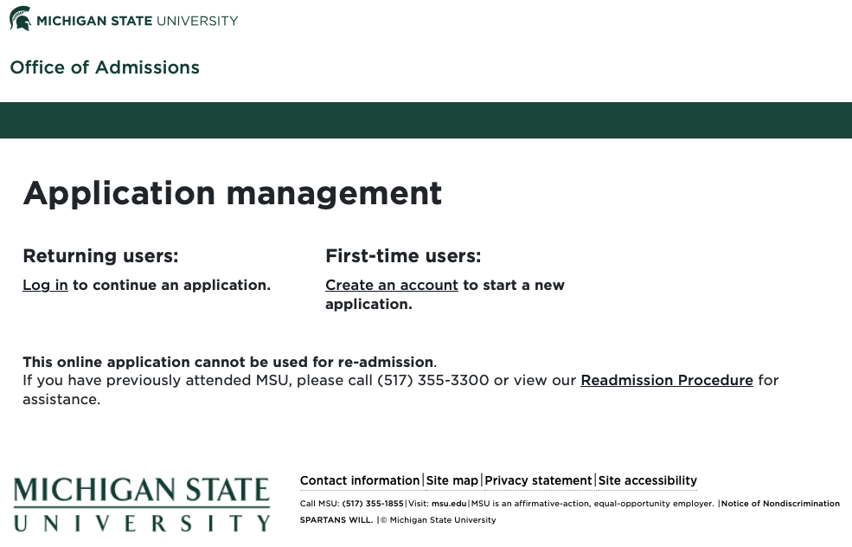
4) Application to MSU as a graduate student in the AFNRE MA
Even though you are currently AFNRE undergraduate students, you still need to apply to MSU as a graduate student in the AFNRE MA program (https://explore.msu.edu/apply/)
https://www.canr.msu.edu/csus/graduate/programs/afnre/

Slide 8
4) Application to MSU as a graduate student in the AFNRE MA
Application Needs
General Online Application Requirements
Applicant Statement
Resume
Three Letters of Recommendation (provide names and emails)
Copy of MSU Transcripts
https://www.canr.msu.edu/csus/graduate/programs/afnre/

Slide 9
Questions?
Contact
Michael Everett, GPD AFNRE MA
everettm@msu.edu or 517-581-5888
https://www.canr.msu.edu/csus/graduate/programs/afnre/

